Slide 1
Chapter 3
Global Supply Chain Quality and International Quality Standards

Slide 2
Chapter Objectives
1. Understand the importance of quality in global economics.
2. Explain the role of culture in quality approaches.
3. Explain the Baldrige award process.
4. Discuss ISO 9000:2015 and how it is used in firms.
5. ISO 9001
6. ISO 14000
7. ISO 28000
8. ISO 31000
9. Case Studies
10. New Trends

Slide 3
Quality: The Foundation of Competitive Advantage
Cost Reduction: Quality systems reduce defects, rework, and waste by 15-25%.
Customer Satisfaction: 82% of consumers prefer companies with real-time transparency [1].
Market Access: ISO certification enables internationalization and global expansion [2].
Risk Management: Proactive quality systems prevent disruptions and crises.
[1]. Sensos.io Future of Supply Chains Report (2024).
[2]. ISO 9001 Council (2024).

Slide 4
The Baldrige Performance Excellence Program
One of the most powerful self assessment mechanisms
Award is open to small (fewer than 500 employees) and large firms (more than 500 employees) in the manufacturing, healthcare, education not-for-profit, and service sectors
Notes:
At the end of Chapter 2, we discussed several operational variables that should be addressed when assessing our future directions for quality improvement. The power of these variables is that they focus management on systemic issues rather than the tactical day-to-day problems.
However, management needs a means for assessing the approaches it has employed to improve operating performance. One of the most powerful self-assessment mechanisms is the Baldrige Performance Excellence Program (hereafter referred to as Baldrige). The success of the Baldrige program in the United States has influenced international practice and has formed the basis for several international awards. A comprehensive list of Baldrige winners is shown in Table 3-2.

Slide 5
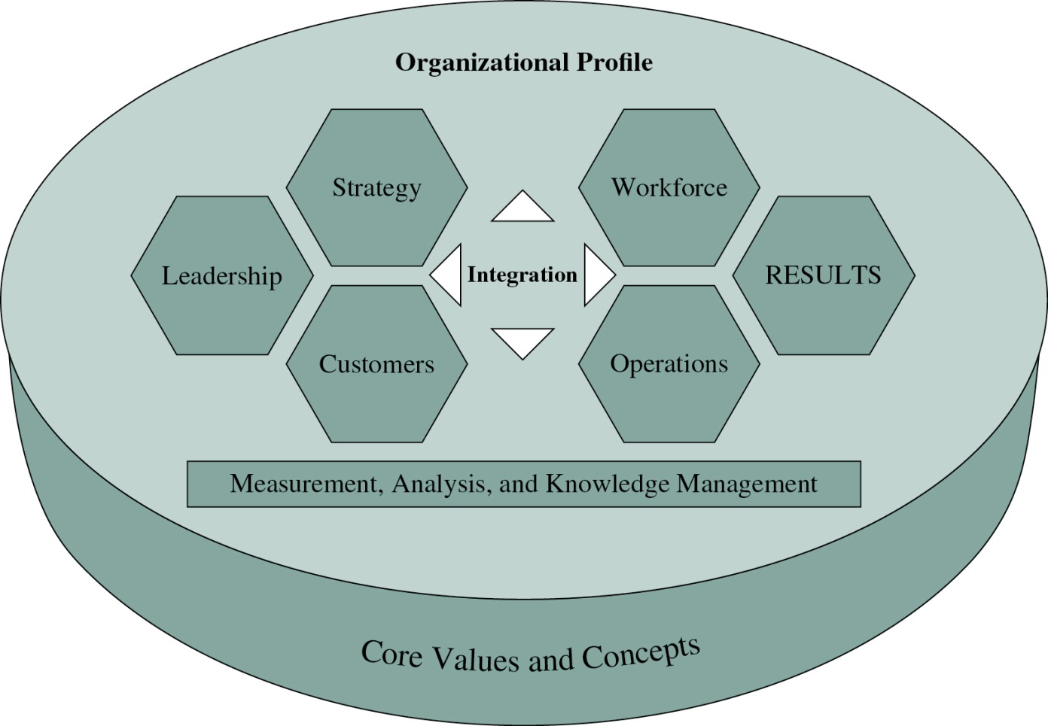
Baldrige Award Framework
Foundation for the Malcolm Baldrige Award, 2015. Criteria for Performance Excellence, 2015.
Figure 3-5
Notes:
The model for the Baldrige consists of seven interrelated categories that comprise the organizational system for performance. The seven Baldrige categories are shown in Figure 3-5. Notice that the basis of the Baldrige model is information and analysis, which confirms the core value of management by fact. Business results are also highlighted, reinforcing the results orientation of the Baldrige framework and criteria. Each of these seven major categories is divided into items and areas to address. The items are denoted by a decimal number, such as 1.1, 2.2, and so on. The areas are given a letter, such as 1.1.a, 2.2.b, and so forth. The number of items and areas varies from year to year because the award criteria are constantly updated by the Baldrige staff, examiners, and judges.

Slide 6
Baldrige Award Criteria
Category 1 Leadership
Category 2 Strategic Direction and Tactical Action Plans
Category 3 Customer Focus
Category 4 Measurement, Analysis, and Knowledge Management
Category 5 Workforce
Category 6 Operations
Category 7 Operational and Business Results
Notes:
We briefly discuss the Baldrige criteria. A complete set of the Baldrige criteria can be downloaded for free from www.nist.gov.
Category 1 This category is used to evaluate the extent to which top management is personally involved in creating and reinforcing goals,
values, directions, customer involvement, and a variety of other issues.
Category 2 focuses on how the company establishes strategic directions and how it sets its tactical action plans to implement the strategic plans.
Category 3 addresses customer focus. To be successful in serving the customer, firms must understand the product and service attributes that are important to the customer.
Category 4 relates to the firm’s selection, management, and use of information to support company processes and to improve firm performance.
Category 5 deals with the workforce focus. The workforce is to be enabled to develop and use its full potential, aligned with company objectives.
Category 6 examines key aspects of operations focus. These aspects include customer focus in design, work systems, design for services and products, support processes, and processes relating to partners.
Category 7 documents the results of the other categories and requires a series of tables and graphs that demonstrate the operational and business results of the firm.

Slide 7
Lean Wastes
Shingo’s seven wastes:
  Waste of overproduction
  Waste of waiting
  Waste of transportation
  Waste of processing itself
  Waste of stocks
  Waste of motion
  Waste of making defective products
Notes:
For Toyota Motor Company, the focus was on the continual reduction of waste. Shigeo Shingo, the industrial engineer who was fundamental in helping Toyota to reduce
waste, identified a group of seven wastes that workers could address in improvement processes.

Slide 8
Are Quality Approaches Influenced by Culture?
United States
  Command-and-control oriented
  Results oriented
Japanese
  Based on ethic of consistency
  Emphasis on reduction of waste
Europeans
  Adopted broad standards that can be adapted to the diverse nation-states in the European Union
  Satisfy employees
  Focus on work as art
  Care for the environment
Notes:
Are other cultures developing quality methods that will be instructive for world competitors? The Russians have long used what is now called group technology to produce products and to improve production. Several Asian Tiger nations, such as Malaysia, South Korea, and Singapore, have begun to make inroads in the field of quality and will become formidable competitors in the future. Chinese quality management is a work in process.

Slide 9
ISO 9000:2015
Three standards:
ISO 9000 – Quality management systems: fundamentals and vocabulary
ISO 9001 – Specific requirements of the standard
ISO 9004 – Managing for the sustained success of an organization
Notes:
By 1997, the ISO 9000 family of documents had become quite cumbersome, with 20 required elements and 12 standards. ISO 9000:2015 is a much simplified document with only six requirements and three standards.

Slide 10
ISO 9000:2015 Seven Principles
Customer focus
Leadership
Engagement of people
Process approach
Improvement
Evidence-based decision making
Relationship management
Notes:
International Organization for Standardization (ISO) Technical Committee (TC) 176 has done an excellent job of responding to the critics of the original standard by focusing on these quality management principles. Note the similarities between these principles and the Baldrige categories.

Slide 11
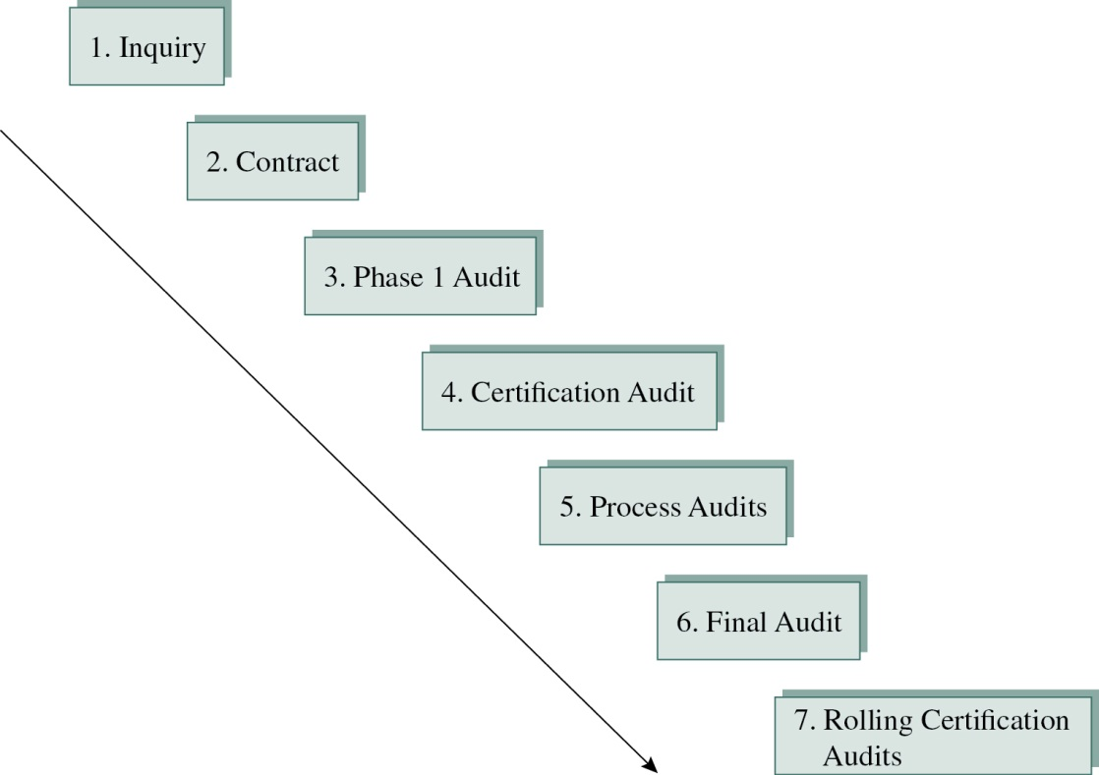
ISO 9000:2015 Process
Figure 3-8
Notes:
Although many companies have now transitioned from ISO 9001 (2000) to ISO 9000:2015, we identify a process for the first-time registering firm. The registration process for ISO 9000:2015 (including the new ISO 9001:2015) typically takes several months from initial meeting to final registration audit. This time frame differs from client to client, but each process usually follows the steps outlined in Figure 3-8.

Slide 12
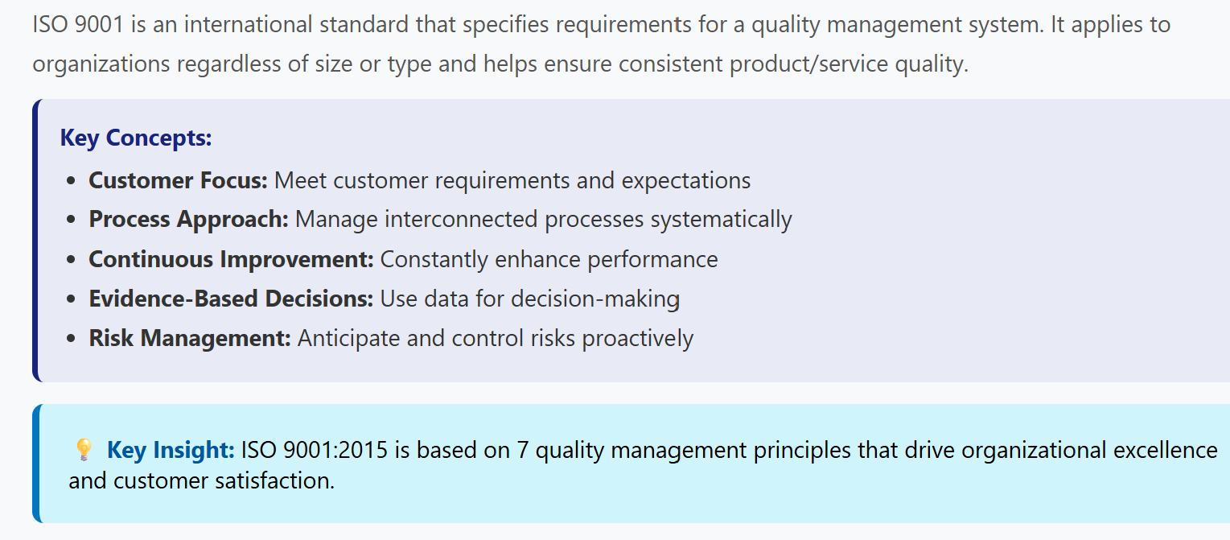
ISO 19001

Slide 13
ISO 14000
International standard for environmental compliance
Uses the same basic approach as ISO 9000:2015
Also includes quantified targets, established objectives, emergency and disaster preparedness, and disclosure of environmental policies
Notes:
Given the success of ISO 9000:2015, ISO developed an international standard for environmental compliance called ISO 14000.
Such a system may provide the basis for developing a comprehensive environmental management system.

Slide 14
ISO 14000 Elements
International Standards Organization, Geneva, Switzerland, 2010. Used with permission of Capaccio..
Table 3-6
Notes:
Table 3-6 presents the ISO 14000 elements. The process for documenting these elements and seeking registration mirrors the ISO 9000:2015 process. Again, a key process has to do with selecting the appropriate registrar.

Slide 15
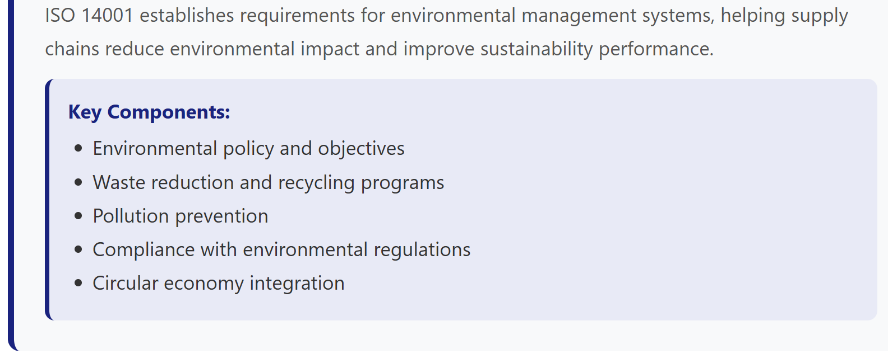
ISO 14001: Environmental Management

Slide 16
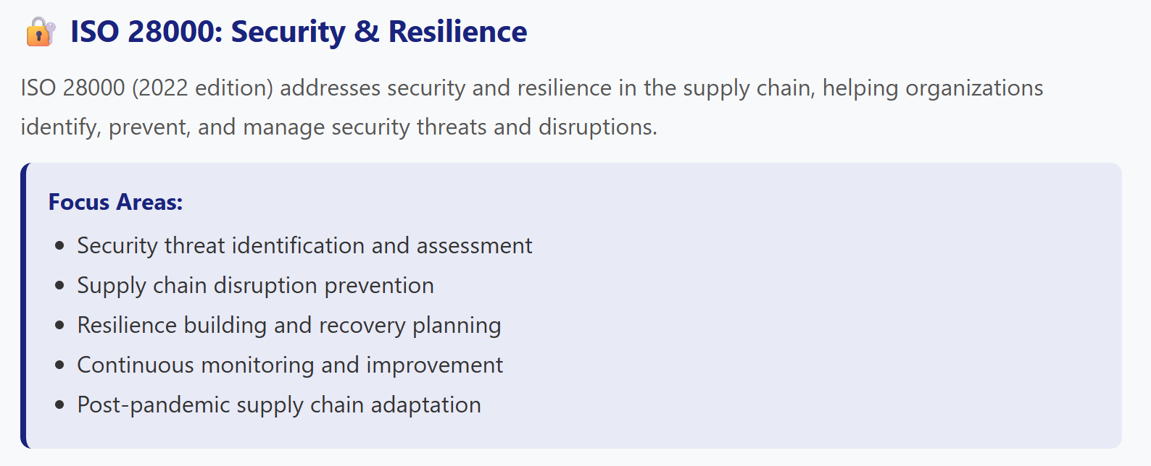
ISO 28000: Security and Resilience

Slide 17
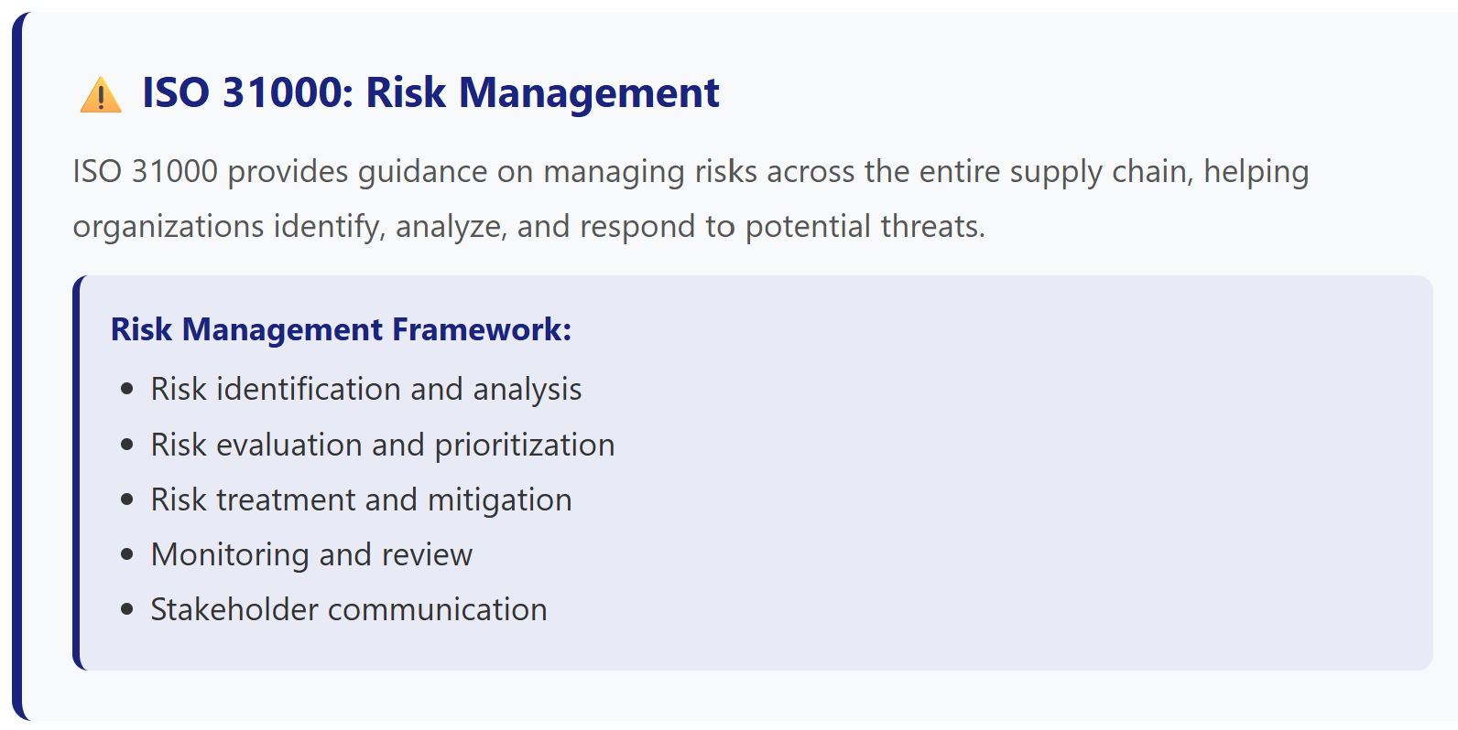
ISO 31000: Risk Management

Slide 18
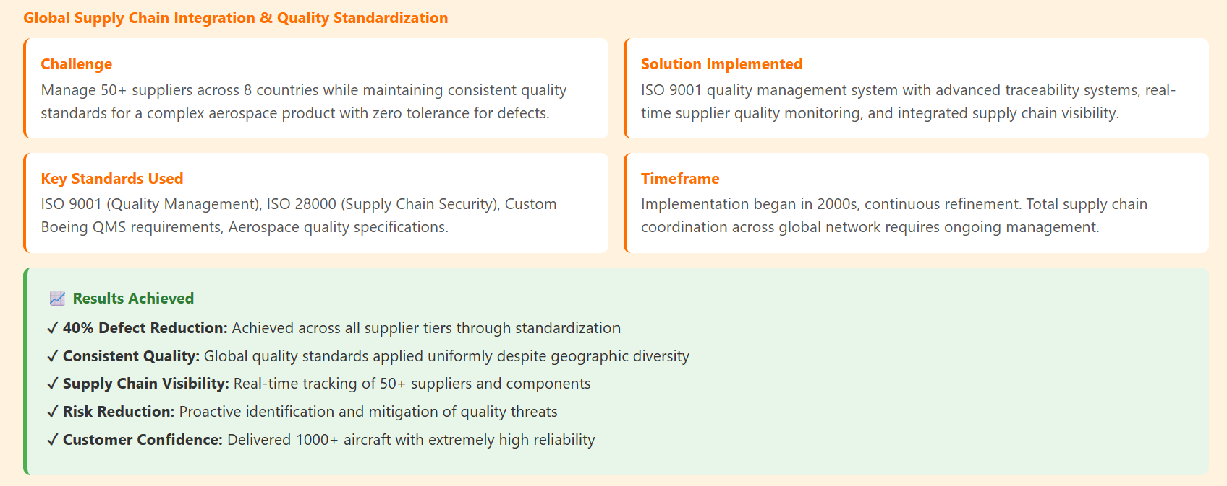
Case study 01: Boeing 787 Dreamliner

Slide 19
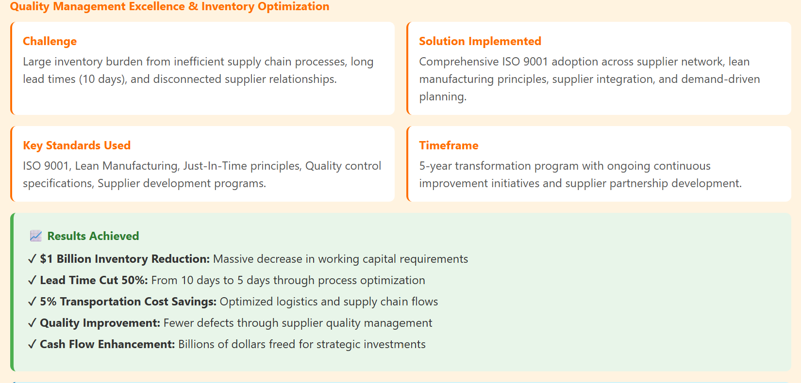
Case study 02: Deere & Company

Slide 20
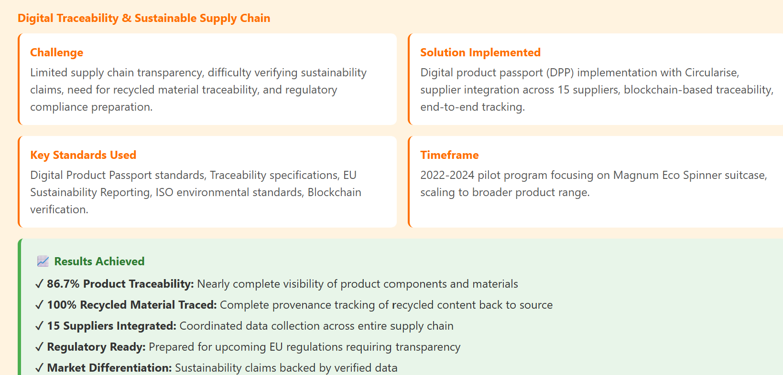
Case study 03: Samsonite digital product passport

Slide 21
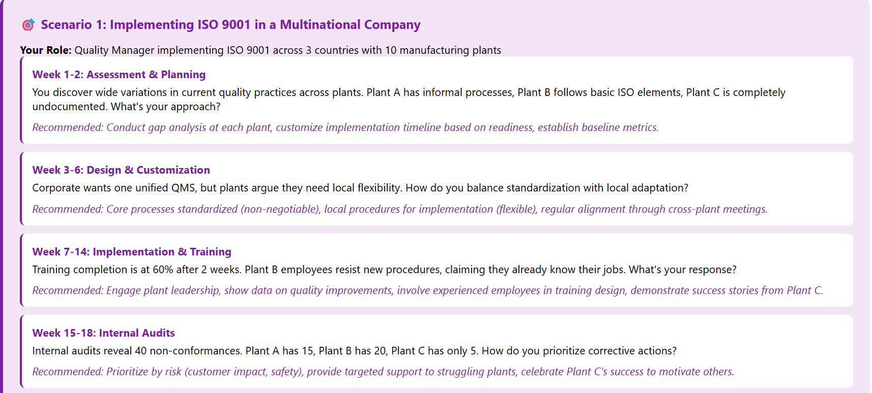
Scenario 01: Implementing ISO 9001 in a company

Slide 22
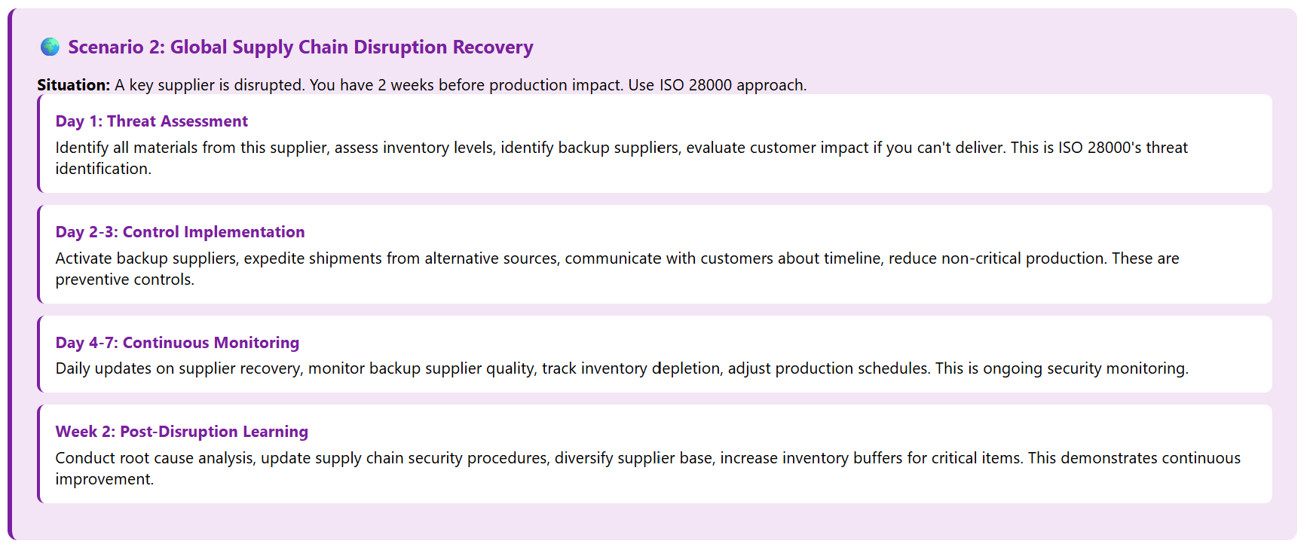
Scenario 02: Global Supply Chain Disruption Recovery

Slide 23
New Trends in Supply chain Quality
Digital Product Passports (DPP): Product traceability from throughout life cycle.
AI & Predictive Quality: Machine learning predicts quality issues before they occur
Blockchain for Transparency: Immutable ledgers ensuring supply chain data integrity through tamper‑proof, auditable transaction records.​
IoT Sensors: Real‑time monitoring of product quality​
Circular Economy Integration: ISO and related standards expanding to include product lifecycle management
Sustainability Reporting: CSRD (Corporate Sustainability Reporting Directive) and ESG metrics requiring standardized disclosure of environmental and social performance.​

